Slide 1

GRANDMA / SNEWS
Laisney Clément
22/07/2021

Slide 2
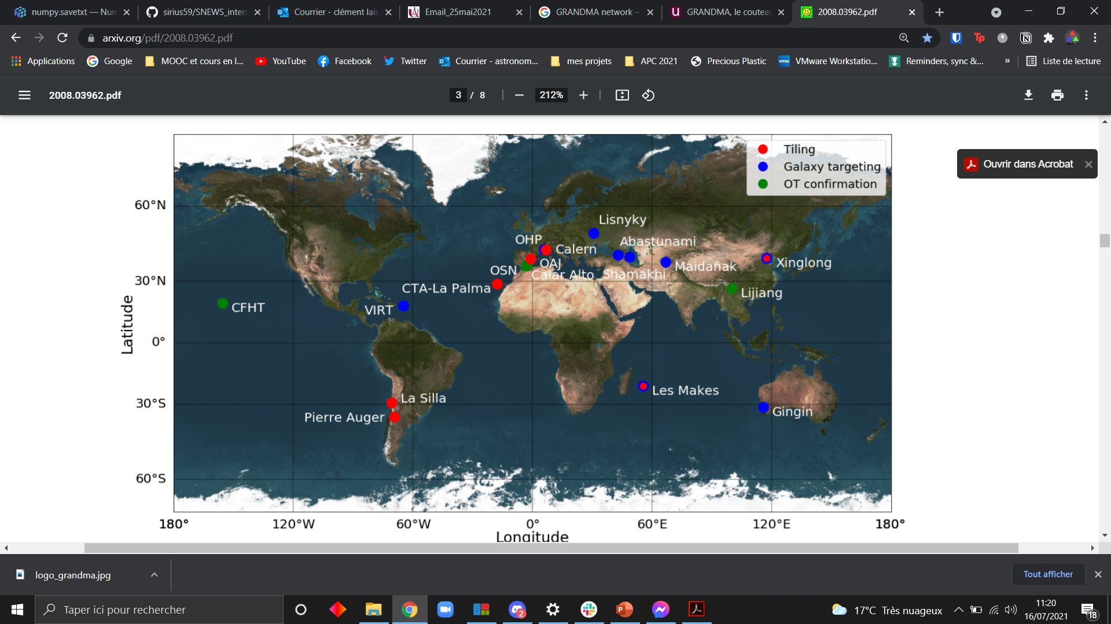
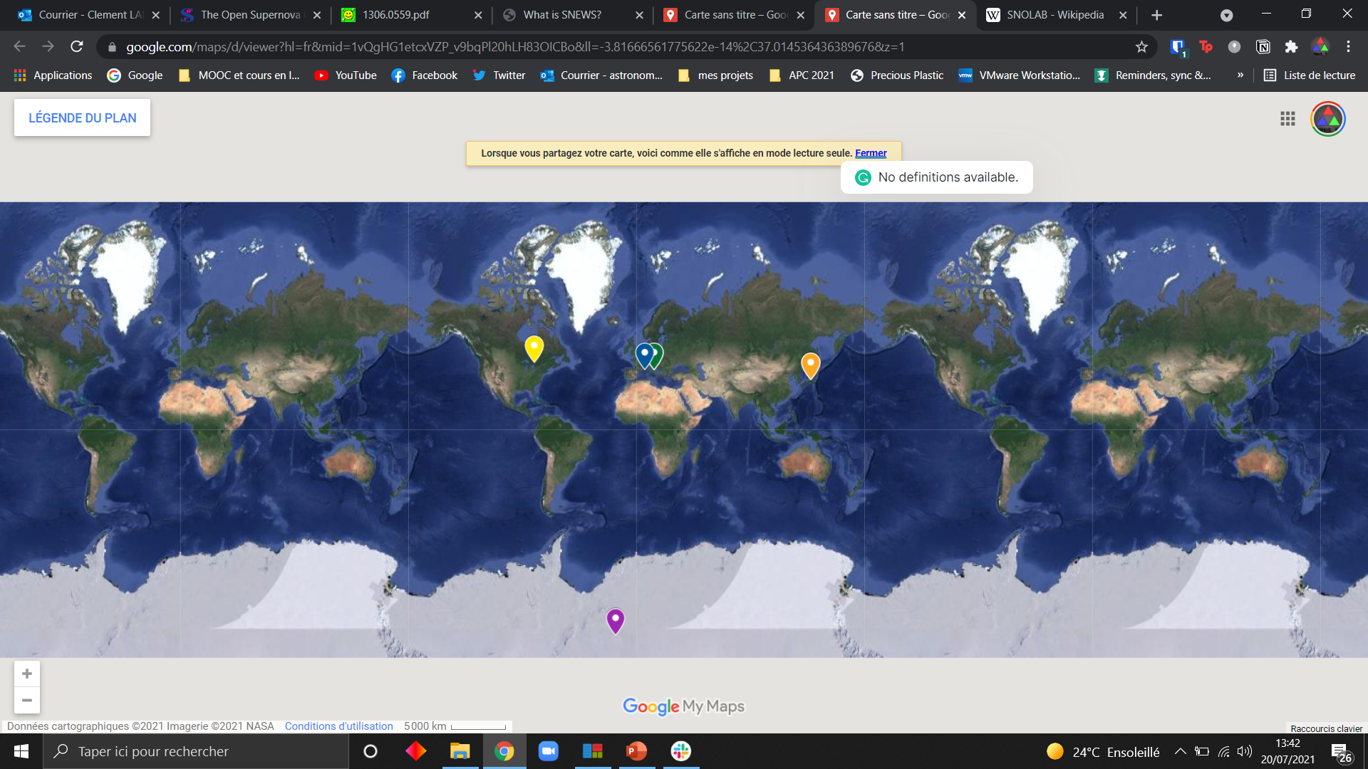
GRANDMA / SNEWS
GRANDMA : a world wide robotic telescope network.
SNEWS: SuperNova Early Warning System
7 Neutrinos detectors
-> SuperK, LVD, KamLAND, Ice Cube, KM3NeT, Borexino, HALO.
Detect MeV neutrinos
SNEWS plan to trigger alert as soon as galactic CCSN detected + triangularize the source location (similar to LIGO/VIRGO)
Credit: GRANDMA: A NETWORK TO COORDINATE THEM ALL

Slide 3
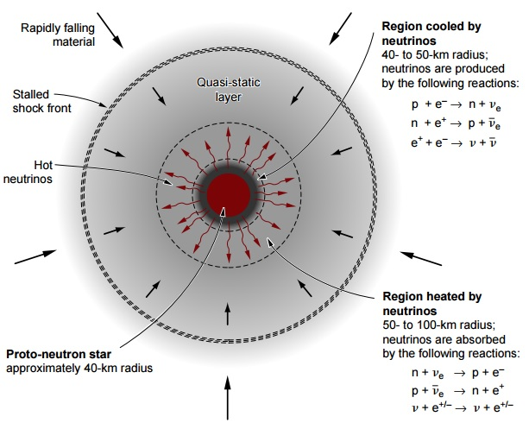
Physics of Core collapsing SN
Massive stars progenitors (>8 Msun)
SN type Ib/c and SN II
Core collapse (neutrinos are immediatly emitted)
Progenitors density ~atomic density = bounce + shock breakout
Neutrinos = 99% of energy
Photons = ~0.01% of energy
Matter = ~0.99% of energy (kinetic energy)
Notes:
Neutrino qq heurs voire jours avant photons

Slide 4
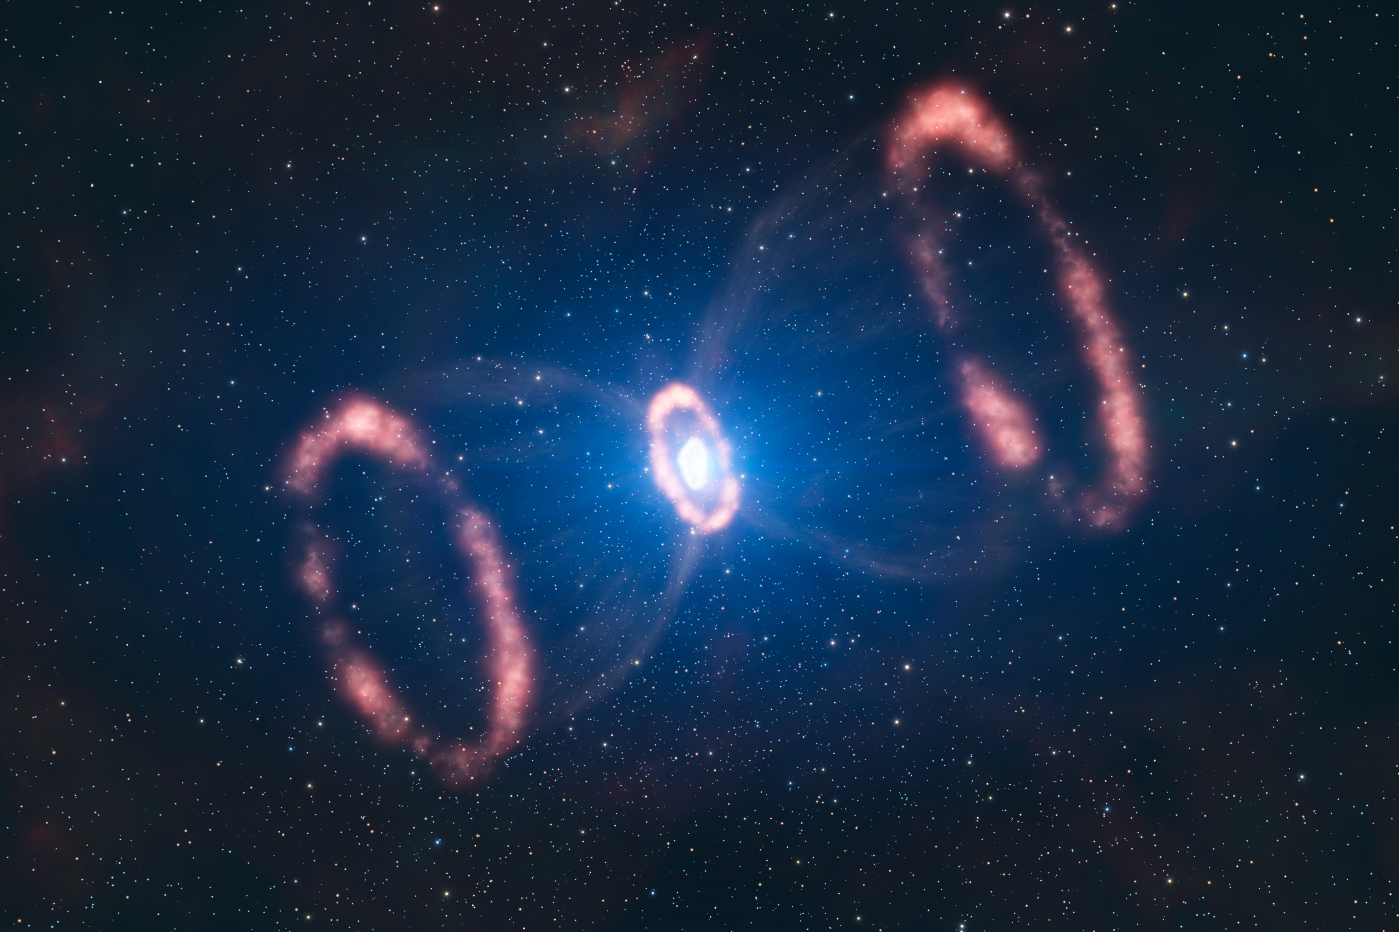
Stakes
SN1987a (Magellanic cloud)-> Neutrino detection first and EM detection (confirm general idea about explosion mecanism)
Many unsolved problems about CCSNe mecanism
Detect EM signal with a great binning of the light curve as soon as possible after the Neutrino signal.
Indirect probes of CCSNe with extragalactic events
Inside the Milky Way (access to neutrino detection)
Last observed Galactic CCSN -> SN1604
~3.2 galactic CCSNe per century (Adams et al. 2013)

Slide 5

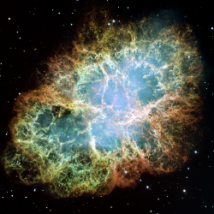
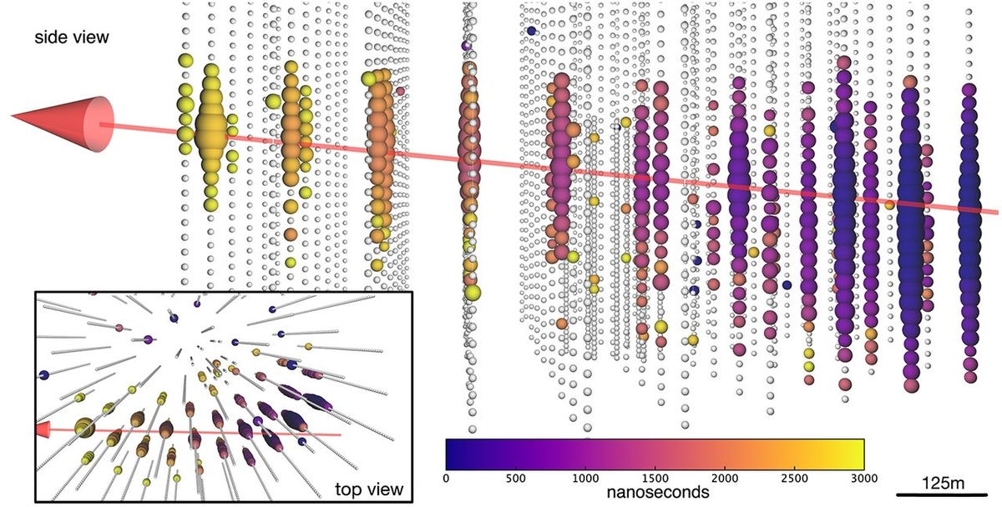
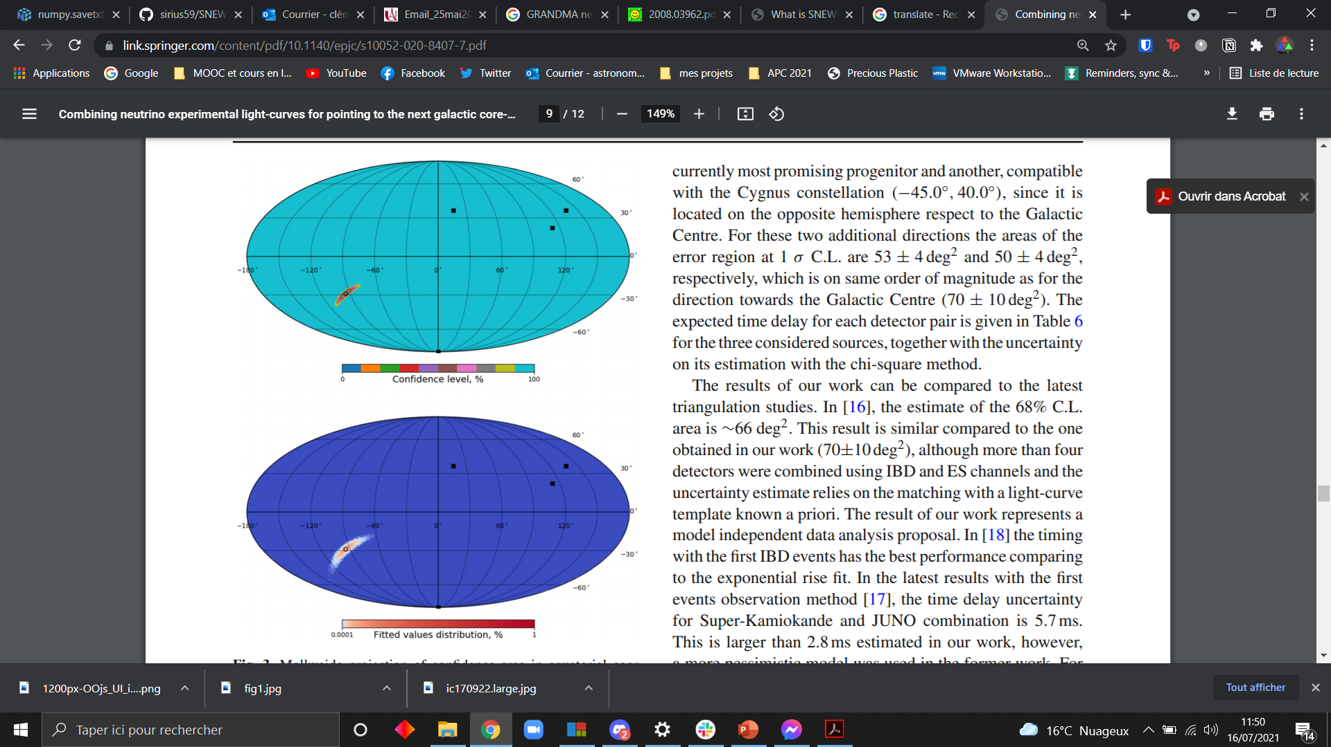

Process
My work
CC SN explosion
Neutrino détection
Triangulation
GRANDMA trigger
Follow up
SNEWS alert

Slide 6
Goals
Where should we look ? (DONE)
Constrain the region in the sky corresponding to the neutrino detection. (Coleiro et al., 2020)
Will we be able to look ? When ? Which instruments to use ?
Simulate galactic CCSNe light curves + EM follow up.
Notes:
~100°² : error box. Importance de plusieurs neutrinos detectors pour triangulariser (ajouter principe de triangulation)

Slide 7
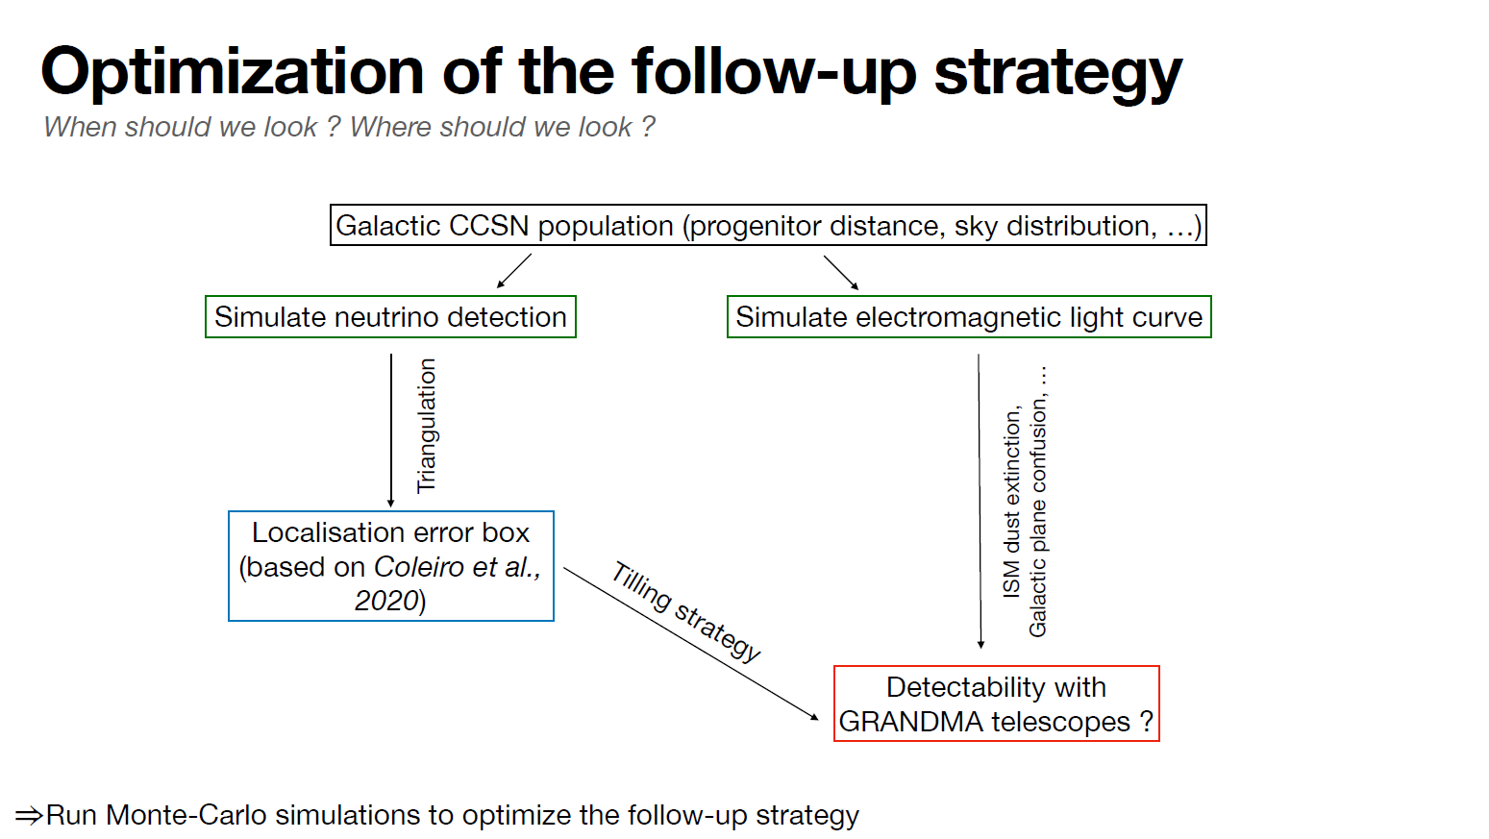
You are Here !
GWEMOPT
Notes:
Idée générale : établir une simulation de montecarlo pour optimiser le follow up grâce aux paramètre de détectabilté

Slide 8
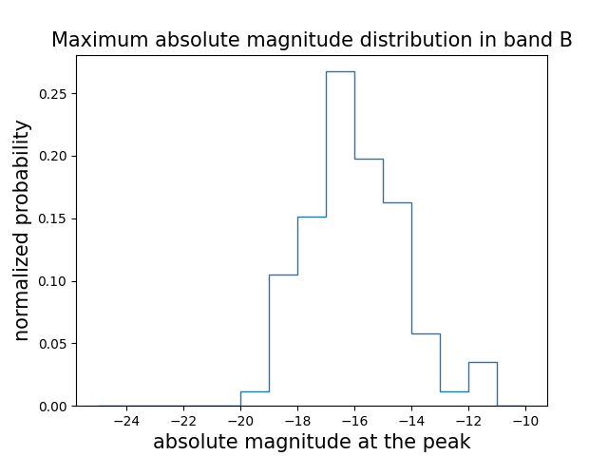
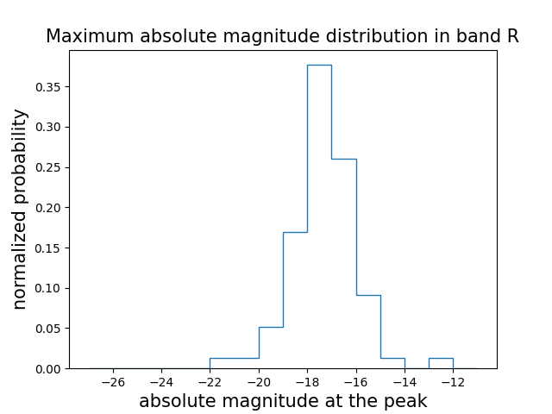
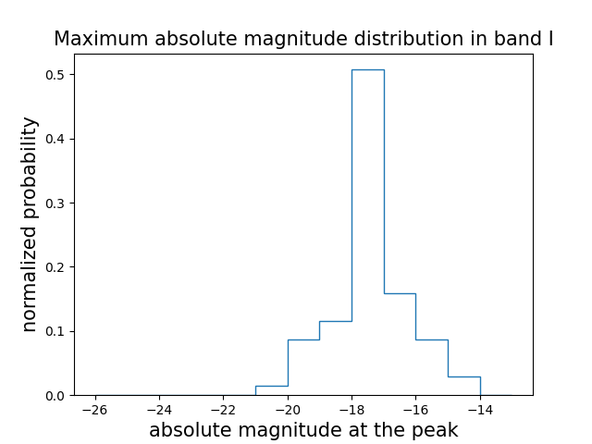
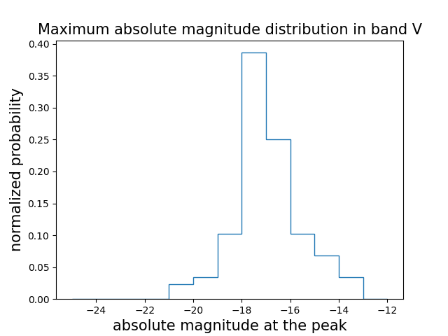
Maximum absolute magnitude distribution
Get 89 extra galactic SN Ib/c photometric and meta data from The Open SuperNova Catalog
Over 89 SN I b/c events :
Get the apparent magnitude at the peak
Correct the dust extinction for each photometric filter with E(B-V) + extinction law (Cardelli et al. 1989)
Compute the absolute magnitude knowing the distance
Randomly choose an absolute magnitude following these distributions
Notes:
We choose 89 well observed SN (with sufficent photometry)

Slide 9
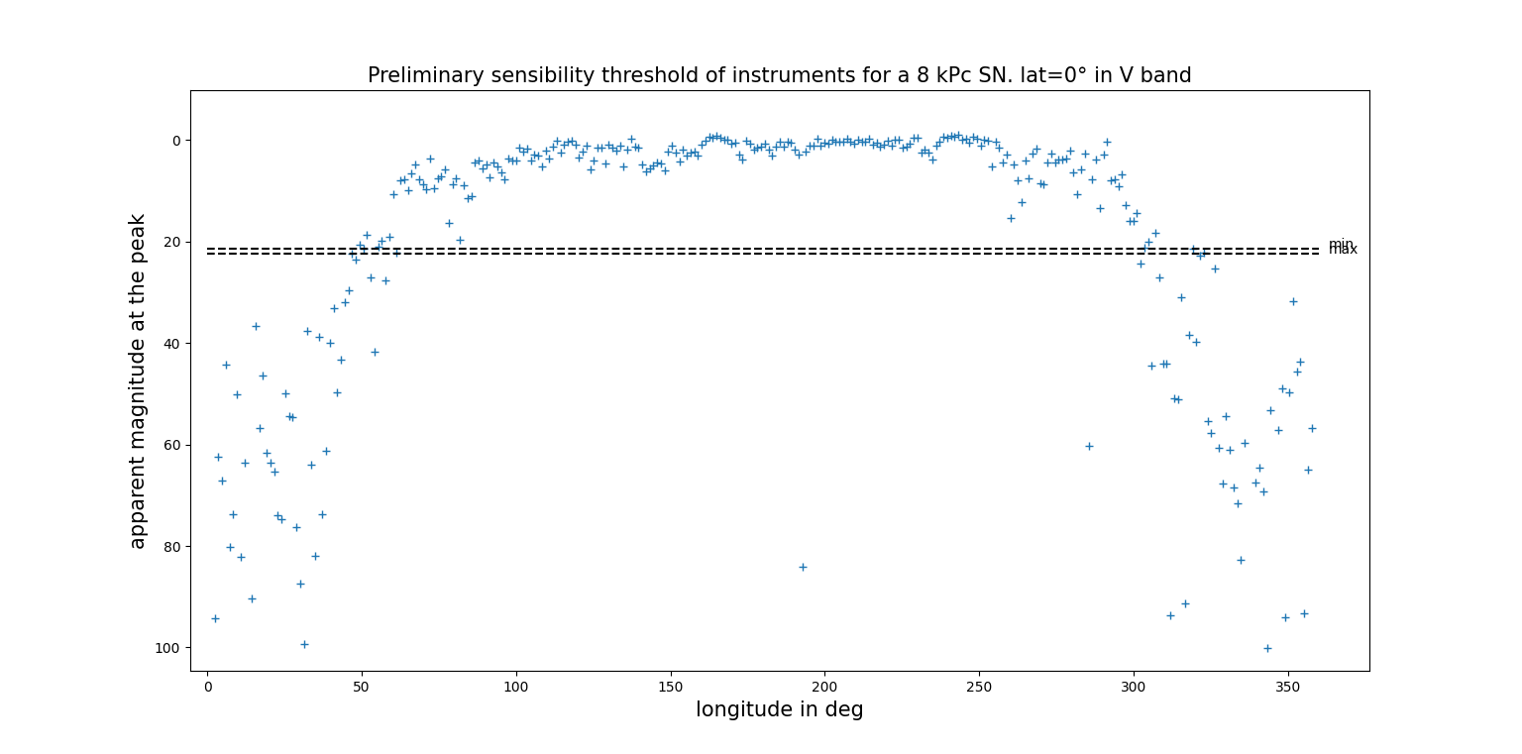
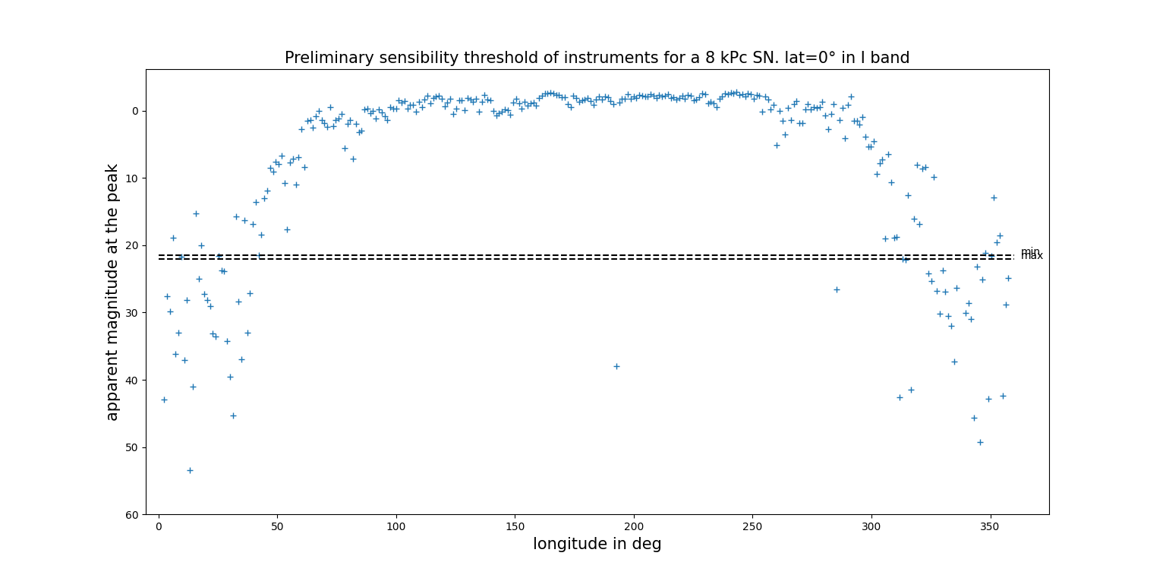
Apparent magnitude vs longitude
Latitude=0° (Galactic coordinate)
Peak value (randomly chosen)
8 kpc
Galactic dust extinction (thanks to a galactic dust map (IRSA-Caltech))
Plot the apparent magnitude vs longitude
Max= maximum sensitivity of GRANDMA
~50° to ~300°: possibility to observe
Wider range in IR (weaker extinction)
Can add a limit for brightest sources

Slide 10
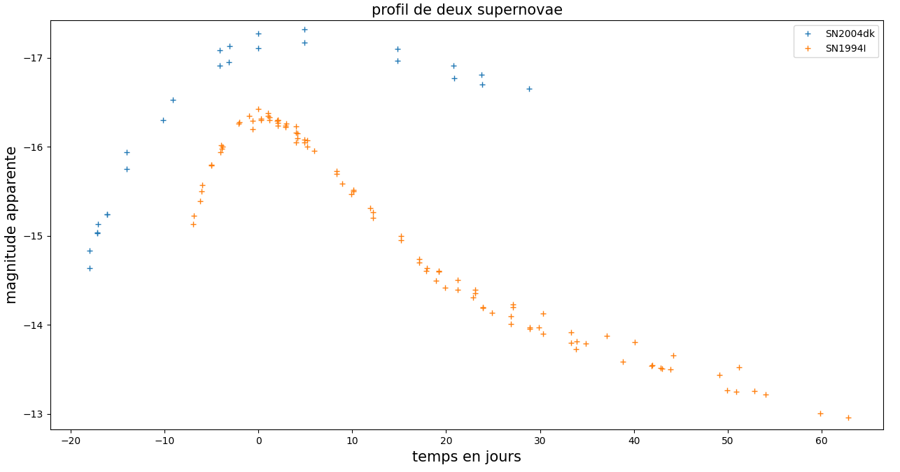
How to simulate these light curves ?
First : Only SN Ib/c type
Light Curve profil based on Weidong Li et al. (2018) method
2 sub-categories
Fast evolving
Slow evolving

Slide 11
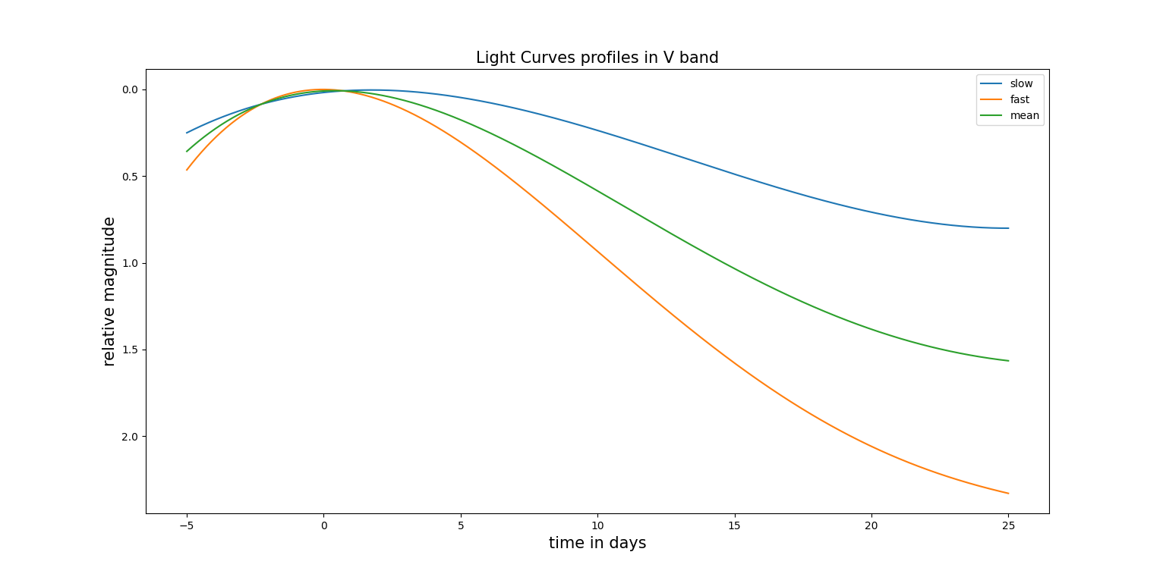
Light curve profil
Fit Fast and Slow photometric data with Splines
Make the mean of this 2 fits
Set the 0 magnitude at the peak

Slide 12
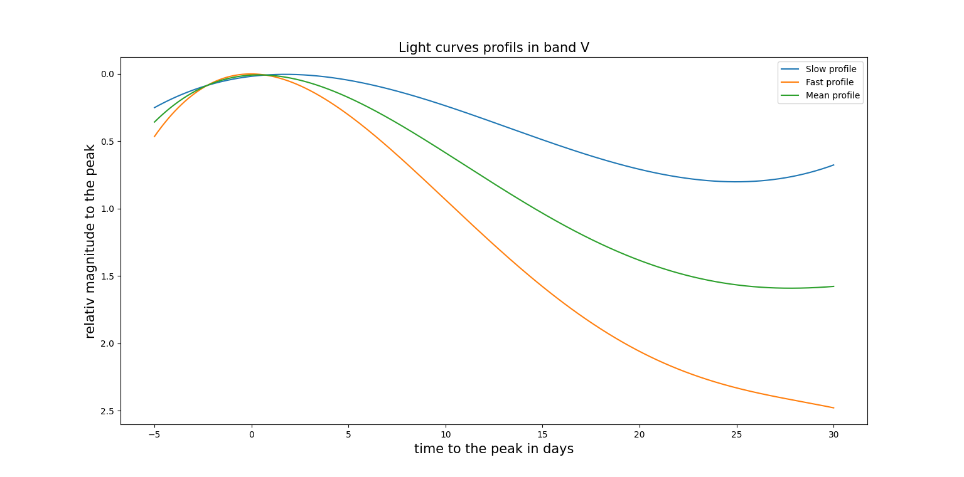

Generate light curves
a
b
Randomly choose a relative magnitude (gaussian distribution) at the begining
Keep the ratio a/b all along the curve
Translate the curve by an absolute magnitude randomly chosen
Pass in apparent magnitude
Add galactic dust extinction thanks to a galactic dust map (IRSA-Caltech)
Fast
Mean
Slow

Slide 13
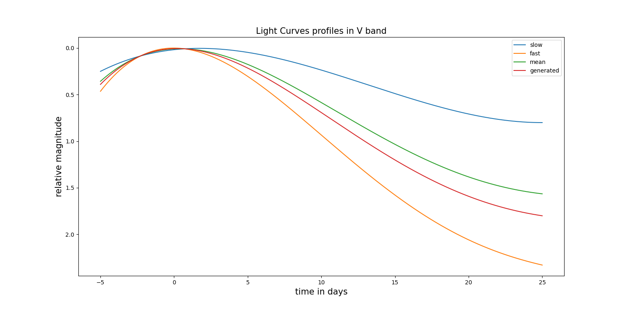

Slide 14
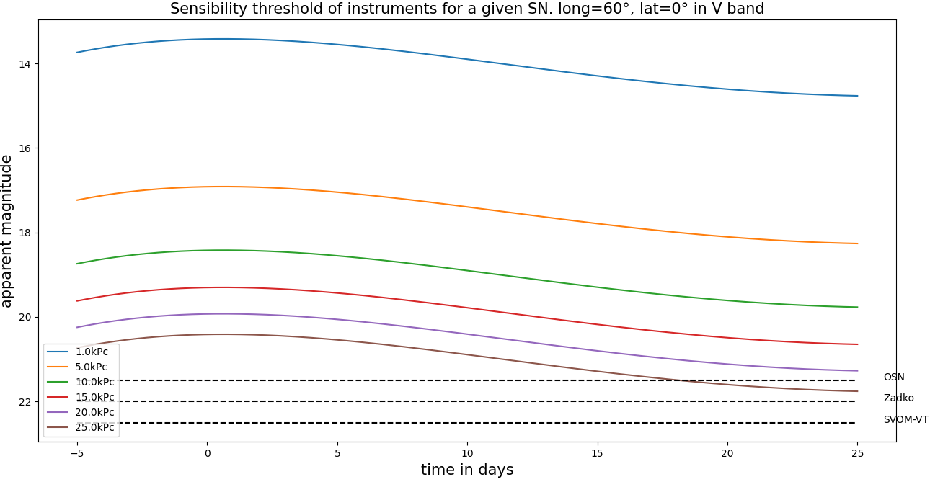
Possibility to detect
Different distances
In the longitude range of observability
Above the lines it is visible
Montecarlo simulation to optimize the GRANDMA follow-up

Slide 15
Upcoming upgrades
Determining the CCSN explosion date by fitting with D.F. Cowen et al. (2018) equations (-> delay time netrino-EM)
Doing the same process with SN II
Adding U, J, H, K bands
Optimize the follow-up with GRANDMA using GWEMOPT
build cumulative distribution of absolute magnitude at peak (through Monte-Carlo simulations)
Compute the time delay between SNEWS alert and first CCSN detection with GRANDMA (to be optimized)

